Slide 1
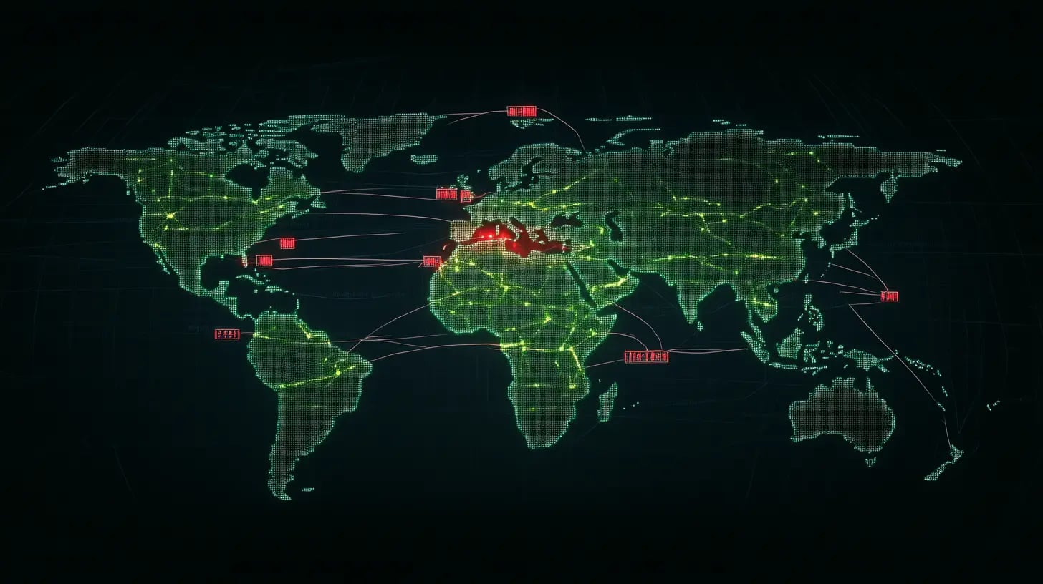
HTTP/2 Rapid Reset Attack
Maria Sfîrăială Andrei Petrea

Slide 2
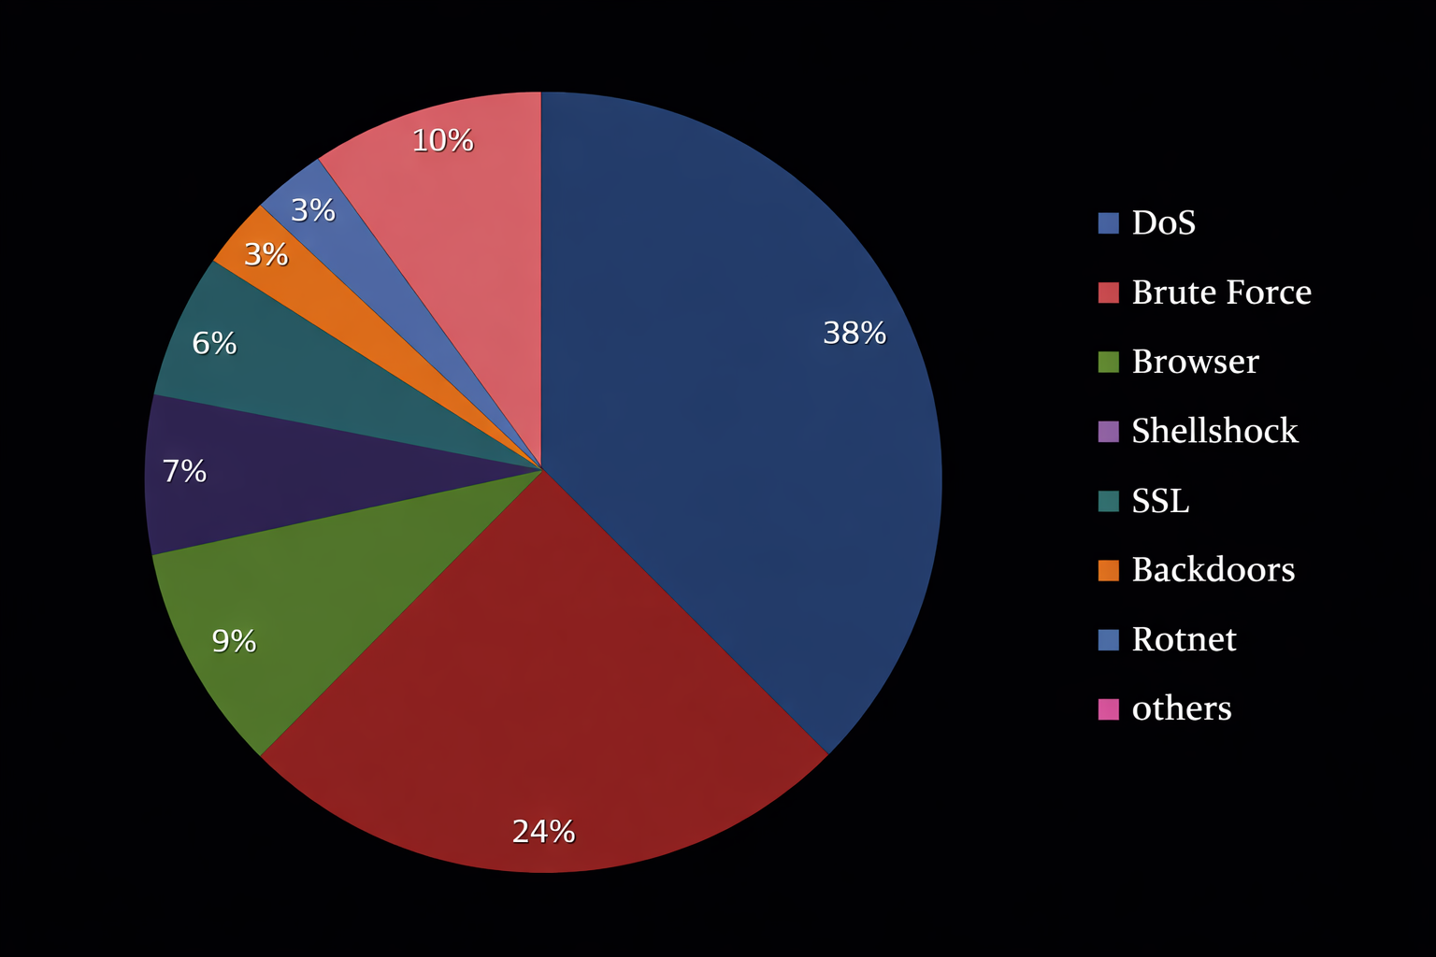
Introduction
Recent top network attacks

Slide 3
HTTP (HyperText Transfer Protocol)
1991 – invented by Tim Berners-Lee
90-98% of internet traffic (51% of all DoS)
3 main versions
HTTP/1.1
HTTP/2
HTTP/3

Slide 4
HTTP/2
2015 – RFC 7540
“Streams” - bidirectional flow of frames between the client and the server
Multiplexing – multiple requests share the same connection
RST_STREAM frame – used by the client to end the connection

Slide 5
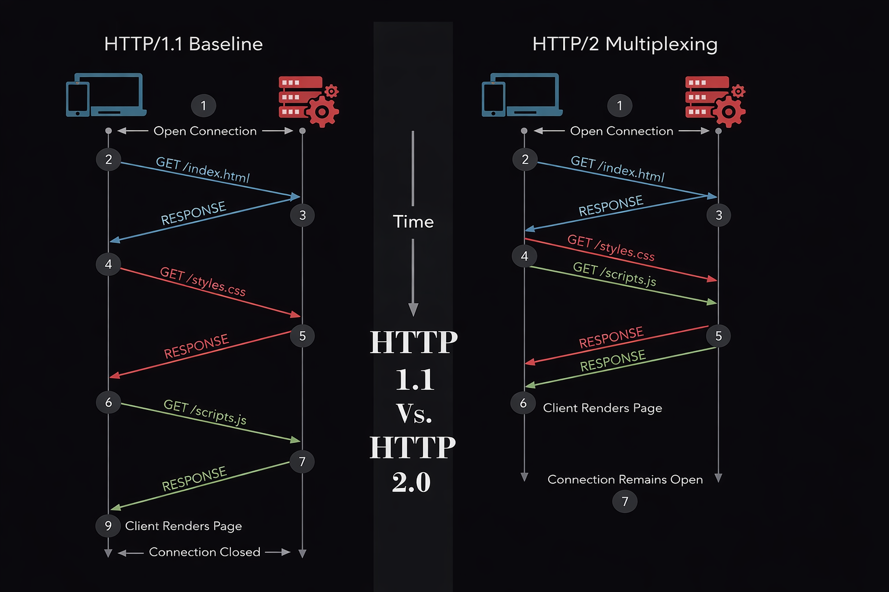
HTTP/1.1 vs HTTP/2

Slide 6
The problem
Unilateral cancellation
No coordination is required — the client may cancel at any time.
Immediate effect assumption
The client assumes the reset takes effect as soon as the server receives it, even before other TCP data is processed.

Slide 7
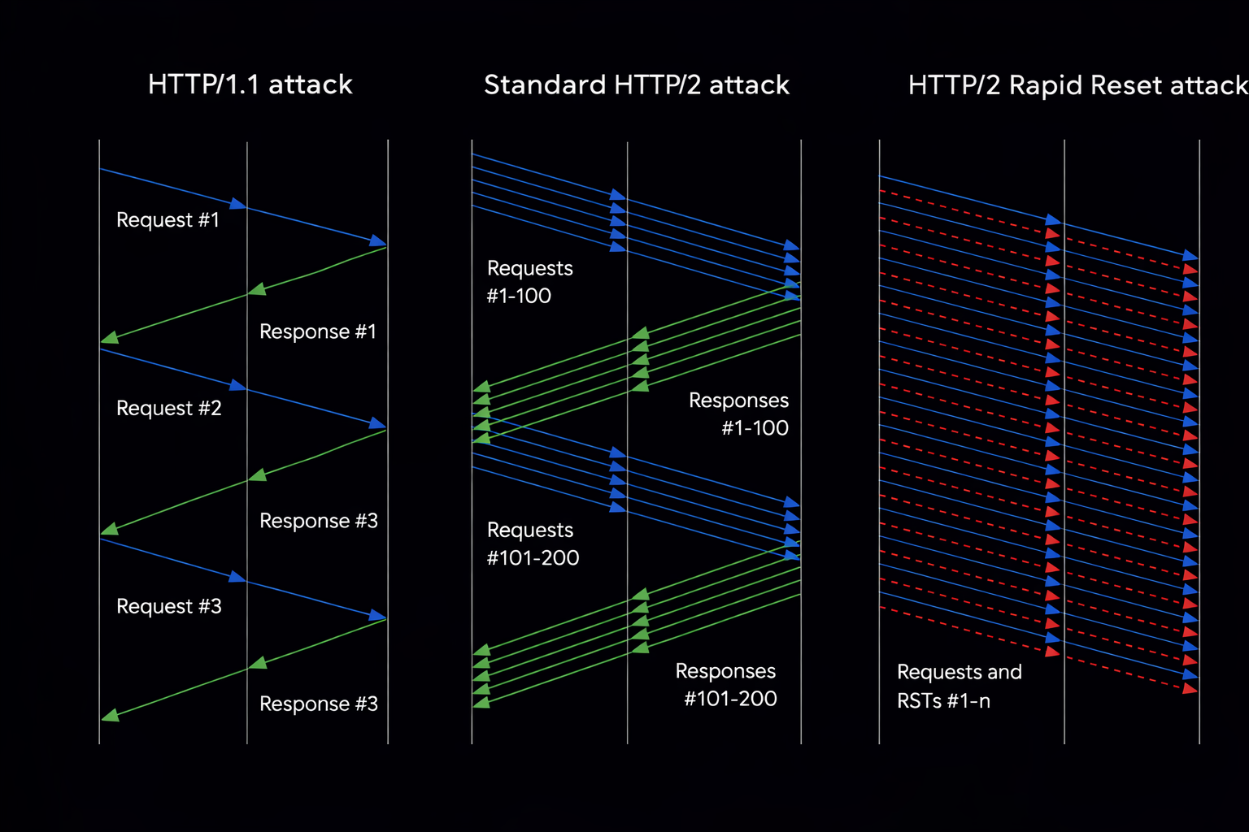
The attack
Client sends a request
Immediately sends RST_STREAM frame
Server begins processing, then rapidly resets the request, but leaving the HTTP/2 connection open

Slide 8
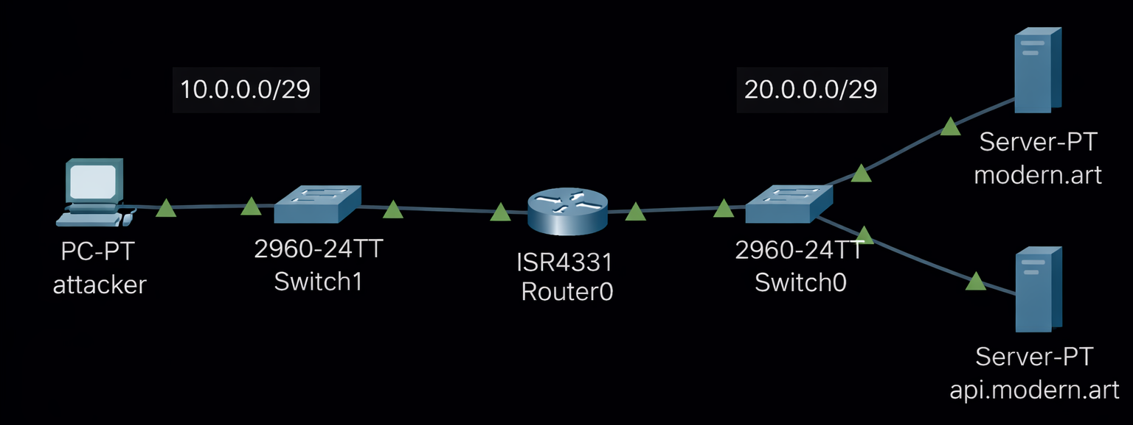
Demo

Slide 9
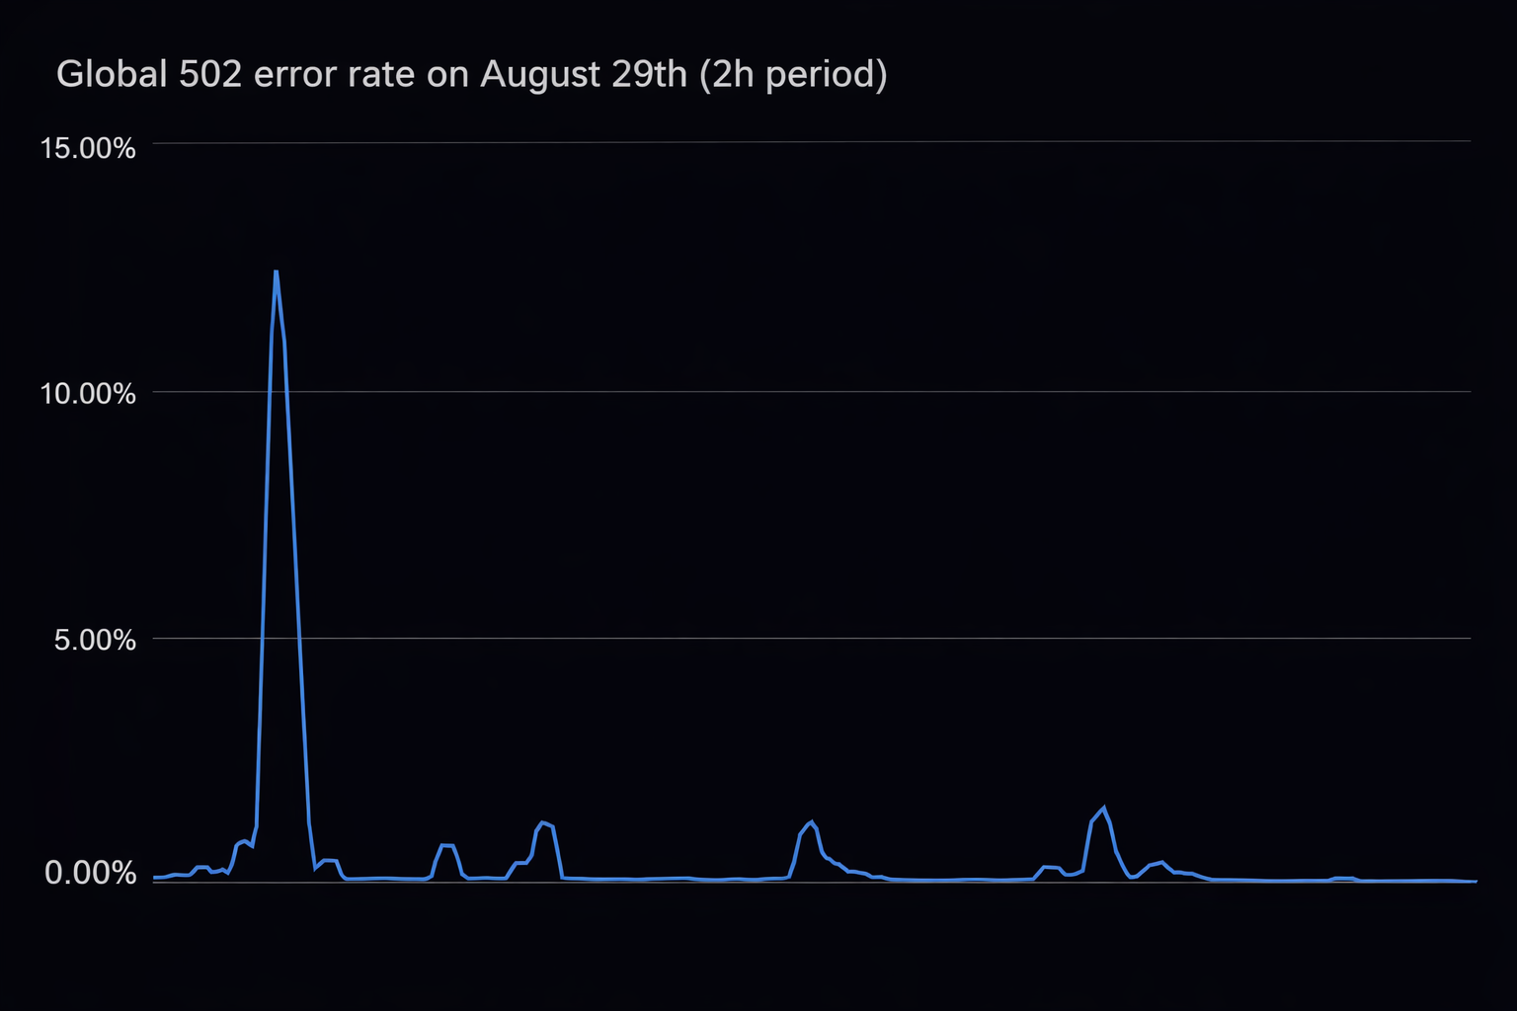
Effects
CVSS : 7.5 HIGH
398 million requests per second at peak
12% of all requests worldwide ended in “502 Bad Gateway” error

Slide 10
Mitigations
Ignore RST_STREAM with idle streams: Clients should ignore RST_STREAM frames received on idle streams. If no request has been sent on a stream, a RST_STREAM is not valid.
Authenticate RST_STREAM: Optionally, clients could authenticate RST_STREAM frames to ensure they originate from the server and not from an attacker. This would require extending the HTTP/2 protocol.
Use HTTPS: Encrypting the traffic with HTTPS (TLS) prevents attackers from seeing which resources are being requested and from injecting forged frames.
Load critical resources early: Load the most critical resources as early as possible in the page lifecycle to reduce the window of vulnerability.

Slide 11
References
HTTP/2 Reset Attack | OWASP Foundation
HTTP/2 Rapid Reset: deconstructing the record-breaking attack
How it works: The novel HTTP/2 ‘Rapid Reset’ DDoS attack | Google Cloud Blog
HTTP/2 vs. HTTP/1.1 | Cloudflare

